Slide 1
TDD,BDD & FDD
Prepared by :Mohammed sayeeduddin

Slide 2
Test-Driven Development (TDD):
Test-Driven Development (TDD) is a software development methodology where developers write tests before writing the corresponding code. The process typically involves writing a failing test, writing the simplest code to pass the test, and then refactoring the code while ensuring that all tests still pass. TDD aims to improve code quality, maintainability, and reliability by continuously testing and validating the behavior of the system throughout the development process.

Slide 3
Use case
Algorithm Development: TDD is well-suited for developing algorithms or functions where the expected behavior is clear and well-defined. By writing tests that specify the desired behavior of the algorithm, developers can iteratively implement and refine the code until it meets the specified requirements.
Regression Testing: TDD helps ensure that changes to existing code do not introduce regressions or unexpected behavior. By maintaining a comprehensive suite of tests that cover all code paths, developers can quickly identify and fix any issues that arise as a result of changes to the codebase.

Slide 4
Code Coverage: TDD encourages writing tests for all possible code paths, thereby ensuring comprehensive code coverage. By writing tests that exercise different branches and edge cases in the code, developers can identify and address potential bugs before they manifest in production.

Slide 5
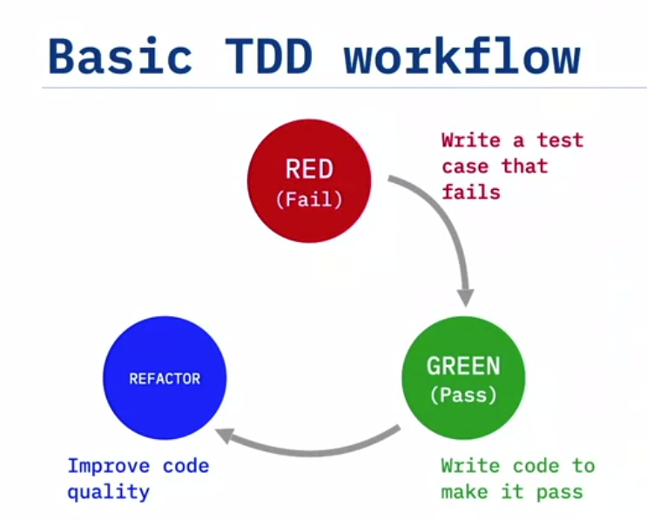
Red, Green Refactor

Slide 6
Why it is Important & Summary:
Why is TDD important for DevOps:
1.It saves time when developing complex feature
2.It allows us to code faster and with more confident
3.It ensures that the code is working as expected
4.It ensures that future change does not break existing code
5.In order to create a DevOps CI/CD Pipeline all testing must be automated
Summary:
It focuses on how the system works from the inside
Test drive the design
We write the test first then write the code to make the test pass

Slide 7
Popular testing framework
Junit for Java
PyUnit for Python
NUnit for .Net
Tools
Coverage
Nose

Slide 8
What is Behavior-Driven Development (BDD)
Behavior-Driven Development (BDD) is a software development methodology that focuses on defining the behavior of the system from the perspective of its stakeholders. It emphasizes collaboration between developers, QA, and non-technical stakeholders to ensure that the software meets the desired business outcomes. BDD encourages the use of a common language to describe the behavior of the system, typically using a structured format like Given-When-Then. (Gherkin Language)

Slide 9
Use case
Writing Acceptance Tests: BDD encourages the creation of acceptance tests that describe the expected behavior of the system in natural language, often using the Given-When-Then syntax. For example, "Given a logged-in user, when they click the 'Add to Cart' button, then the item should be added to their shopping cart."
Clarifying Requirements: BDD helps clarify requirements by creating executable specifications that can be understood by both technical and non-technical stakeholders. By using a common language to describe system behavior, misunderstandings and ambiguities in requirements can be minimized.
Improving Collaboration: BDD facilitates collaboration between developers, QA, and business stakeholders by creating a shared understanding of the system's behavior. By involving stakeholders in the creation and review of behavior specifications, BDD helps ensure that the software meets the needs of its users.

Slide 10
Summary
1.Focuses on the behavior of the system from outside
2.Works great for integration testing
3.Use a syntax both developer and stakeholder can easily understand

Slide 11
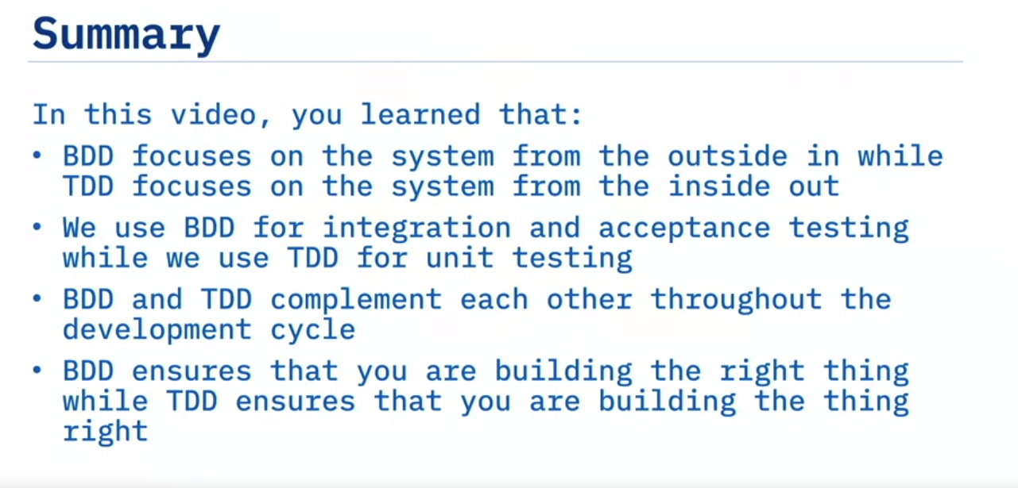
BDD Vs TDD

Slide 12
Feature-Driven Development (FDD)
Feature-Driven Development (FDD) is a software development methodology that emphasizes delivering tangible, working software repeatedly in a timely manner. It focuses on building and designing features incrementally, allowing teams to prioritize and deliver valuable functionality throughout the development process. FDD is characterized by its iterative and feature-centric approach, which enables teams to manage complexity effectively and deliver high-quality software on schedule.

Slide 13
What is Gherkin Language
Gherkin is a structured language used in Behavior-Driven Development (BDD) to describe the behavior of software systems in a human-readable format. It follows a Given-When-Then syntax, which helps to define the preconditions, actions, and expected outcomes of a scenario. Gherkin files typically have the ".feature" extension and serve as executable specifications for the software.

Slide 14
Use case
Feature: Account Management
Scenario: User logs into the system
Given the user is on the login page
When the user enters valid credentials
Then the user should be redirected to the dashboard
And the user should see a welcome message

Slide 15
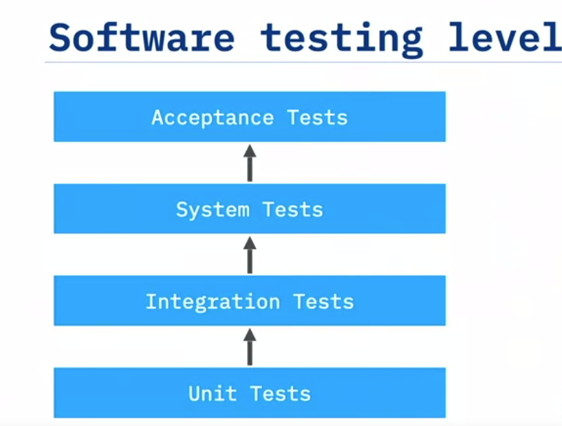
Type of tests

Slide 16
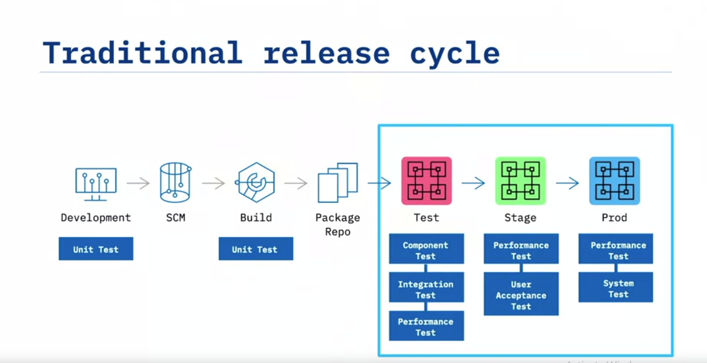
Environment

Slide 17
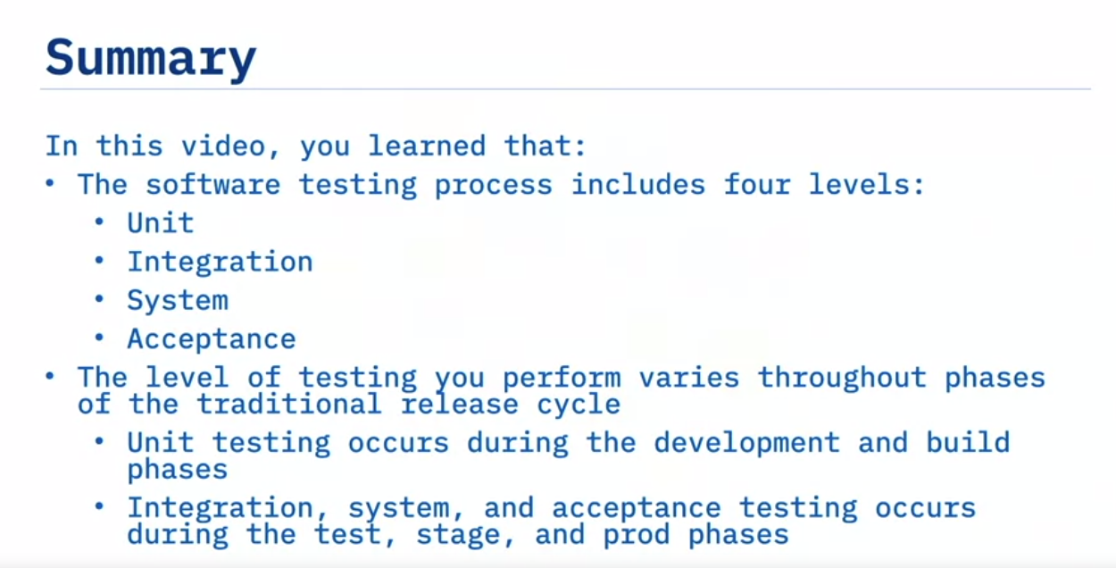
Summary

